Slide 1


Java SE(Core java)
Lecture-28

Slide 2
Today’s Agenda
01
Obtaining description of an Exception
02
Using the keyword throw
03
Checked and Unchecked Exception
05

Slide 3
Obtaining description Exception
• Whenever an exception occurs in try block, java creates an object of a specific
Exception class and stores some important details in the object.
Now using that object we can obtain all the possible details of the exception that
occurred in the catch block.
To do this we can use several methods using the object reference. Some important and common methods are :

Slide 4
Methods
• public String getMessage( ):-
This method is present in the class Throwable.
The method returns “error message” generated by java regarding the exception.
Example:- catch(Exception e)
{
System.out.println(e.getMessage());
}
• public String toString( ):-
This method is present in the Object class hence, in all classes.
It is invoked in two situations
1. In method println( ).
2. Concatenation of object and string.

Slide 5

Overriding the “toString( )
Method
•Example:-
class Person
{
private int age;
private String name;
public Person(int age, String name)
{
this.age=age;
this.name=name;
}
}
class UsePerson
public static void main(String [ ]args)
{
Person p=new Person(21,“Amit”);
System.out.println(p);
}
}

Slide 6
Overriding the “toString( )”
Method
• A hashcode is an unique number generated from any object.This is what allows
objects to be stored/retrieved quickly.
• But it is of no use to programmer or user.
• On passing object reference to println() method, toString()is invoked. Since, we have
not overridden it so the base class version gets called and hence we get hashcode in
return.
• So, by overriding the toString() method we can get information related to a specific
class and not hashcode.

Slide 7

Objects and Classes
class Person
{
private int age;
private String name;
public Person(int age, String name)
{
this.age=age;
this.name=name;
}
public String toString()
{
return name+“, ”+age;
}
class UsePerson
{
public static void main(String [ ] args)
{
Person p=new Person(21,“Amit”);
System.out.println(p);
}
}

Slide 8
•The exception classes have also overridden toString() method, it returns the name of exception along with error message for an exception generated by java.
•The toString() of specific exception class is called as per the object formed in the
try block.

Slide 9
Using “throw” keyword
•In java, exceptions occur on JVM’s choice i.e. anything against java’s flow. Example, if denominator is 0 then java itself generates ArithmeticException.
•But, in some situation a programmers may want to generate or define exceptions on their choice.
• To do this, java provides us the keyword throw. It’s syntax is throw
<Some exception class object reference>;
Let us understand this through an example.

Slide 10
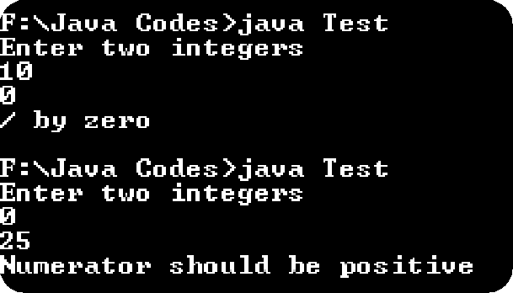
Example
•WAP to accept two integers from user. If the denominator entered is 0 then show java’s exception message and if the numerator entered is 0 then generate your own exception
displayed “Numerator must be positive”.
• Sample Output:-

Slide 11
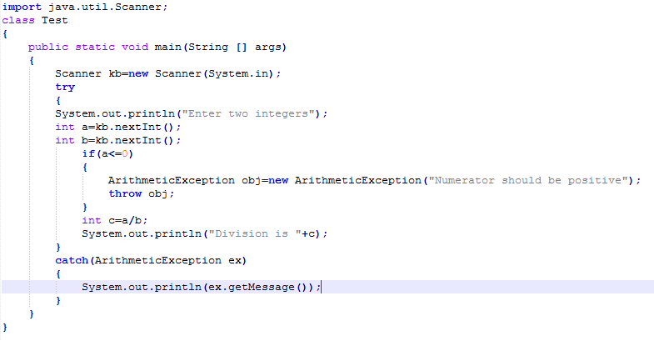
Example

Slide 12
Classification of Exceptions
Checked
Exceptions
Unchecked
Exceptions
Exceptions for which java forces the
programmer to either handle it using
try-catch or the programmer must inform
or warn the caller of the method that his
code is not handling the checked exception.
keyword throws. It is used in the method‘s
prototype along with exception class name.
Exceptions for which java never compels the programmer to handle it.The program would be compiled and executed by Java.Example the class RuntimeException and all its
derived classes fall in this category.

Slide 13
Checked Exception
• This in java is called handle of declare rule.
• The caller also has 2 options, either use try-catch or the keyword throws.
• If every method uses throws, then ultimately the responsibility goes to the JVM
which will follow the standard mechanism of handling the exception.
• All exceptions which are not derived classes of RuntimeException fall in this
category. Like SQLException, IOException, InterruptedException etc…

Slide 14
Code for Checked Exception
import java.io.*;
class Input
{
public static void accept( ) throws IOException
{
System.out.println(“Enter a character”);
char c=(char)System.in.read( );
System.out.println(“You entered ”+c);
}
}
class UseInput
{
public static void main(String [] args) throws IOException
{
Input.accept( );
}
}

Slide 15
Thank you

